Slide 1



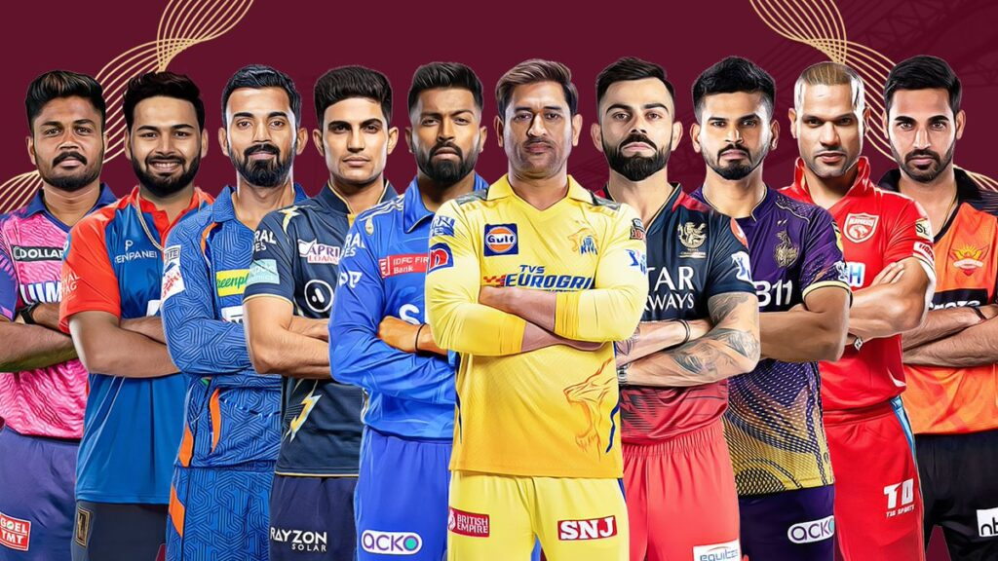



IPL DATASET ANALYSIS
SARANYA R
MAY BATCH - 2025

Slide 2

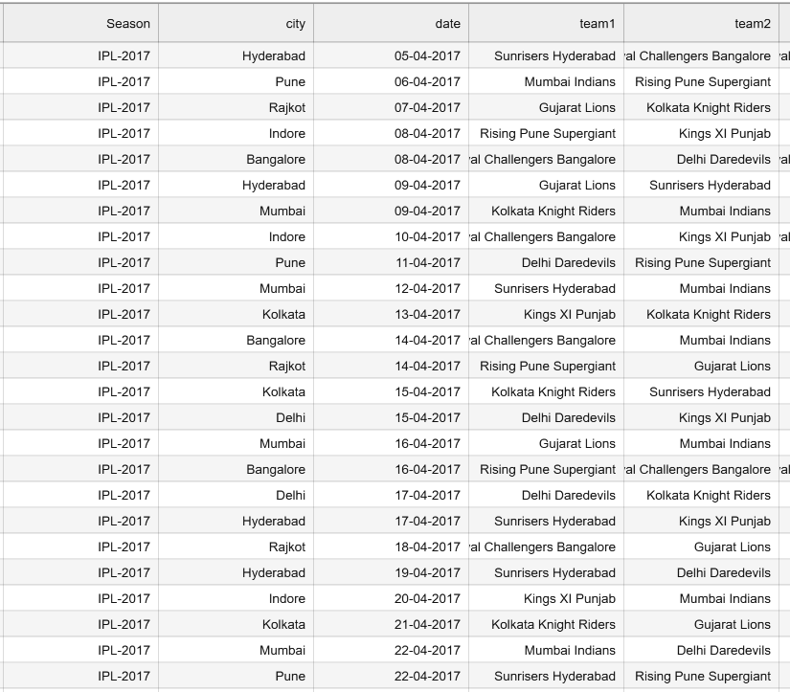


INTRODUCTION
Predicting the winner of an IPL match is challenging due to multiple influencing factors like toss, venue, and team performance.
The dataset contains match details such as teams, toss decisions, results, venues, margins of victory, and player awards.
Features include both categorical (team names, venue, toss decision) and numerical (runs, wickets) data.
Objective: Use machine learning models to predict match winners accurately.
Best model will be selected through evaluation and hyperparameter tuning.

Slide 3


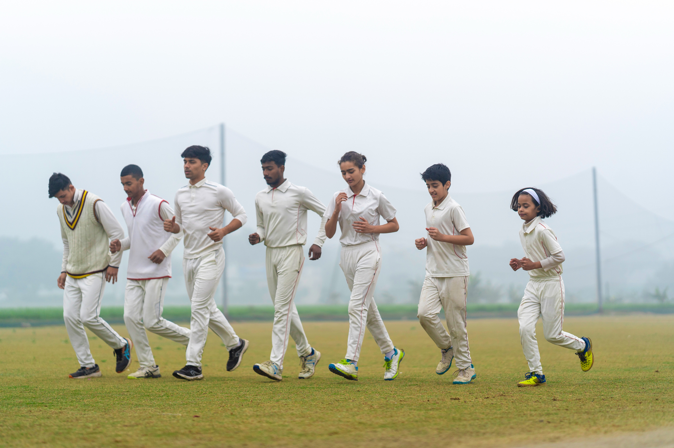
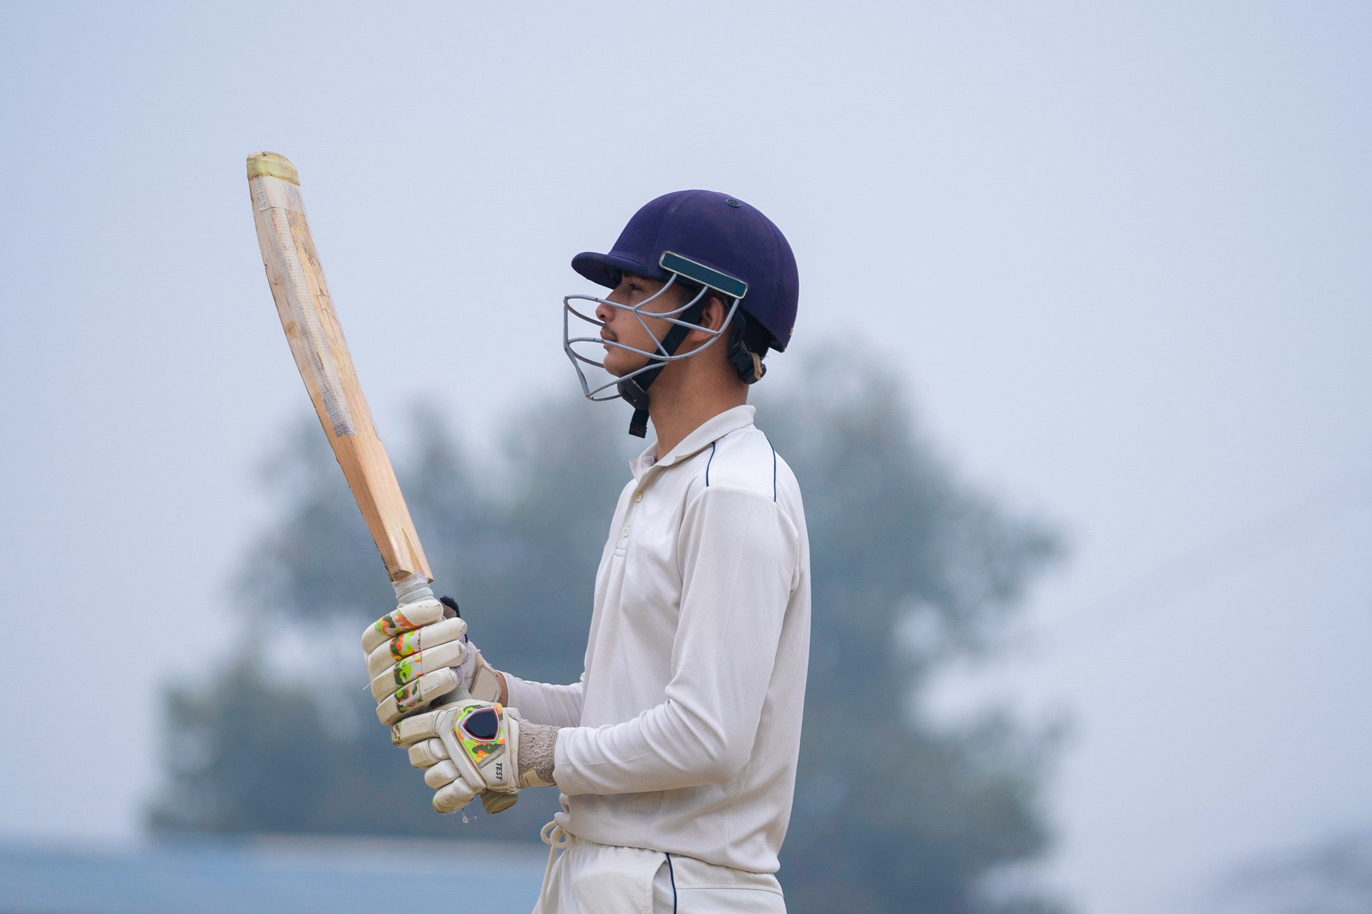
DATA UNDERSTANDING
The dataset contains ball-by-ball and match-level details of IPL games.
Key columns:
Season, City, Date → Match context
Team1, Team2 → Competing teams
Toss_winner, Toss_decision → Toss outcomes
Winner, Result, dl_applied → Match results
Win_by_runs, Win_by_wickets → Margin of victory
Player_of_match, Venue, Umpires → Additional match info
Data includes both categorical (team names, venue, toss decision) and numerical (runs, wickets) features.

Slide 4

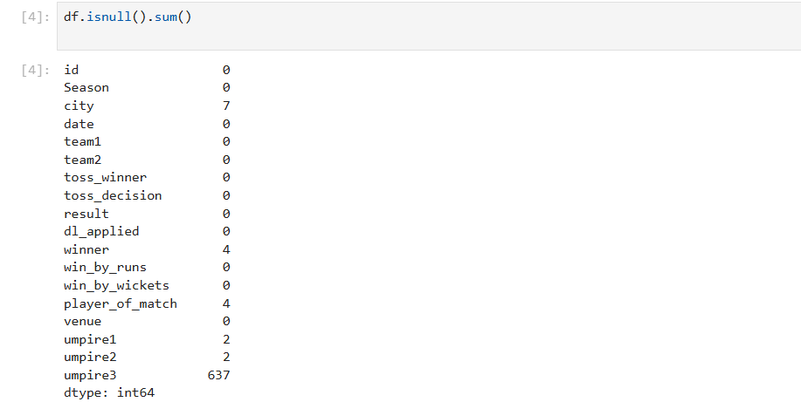
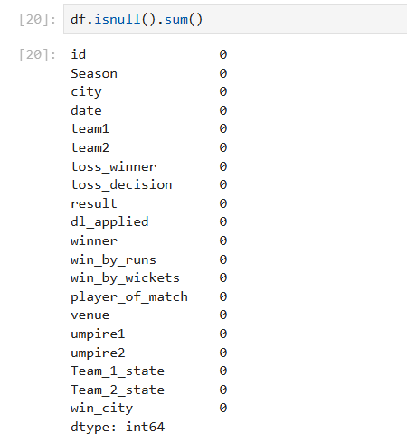
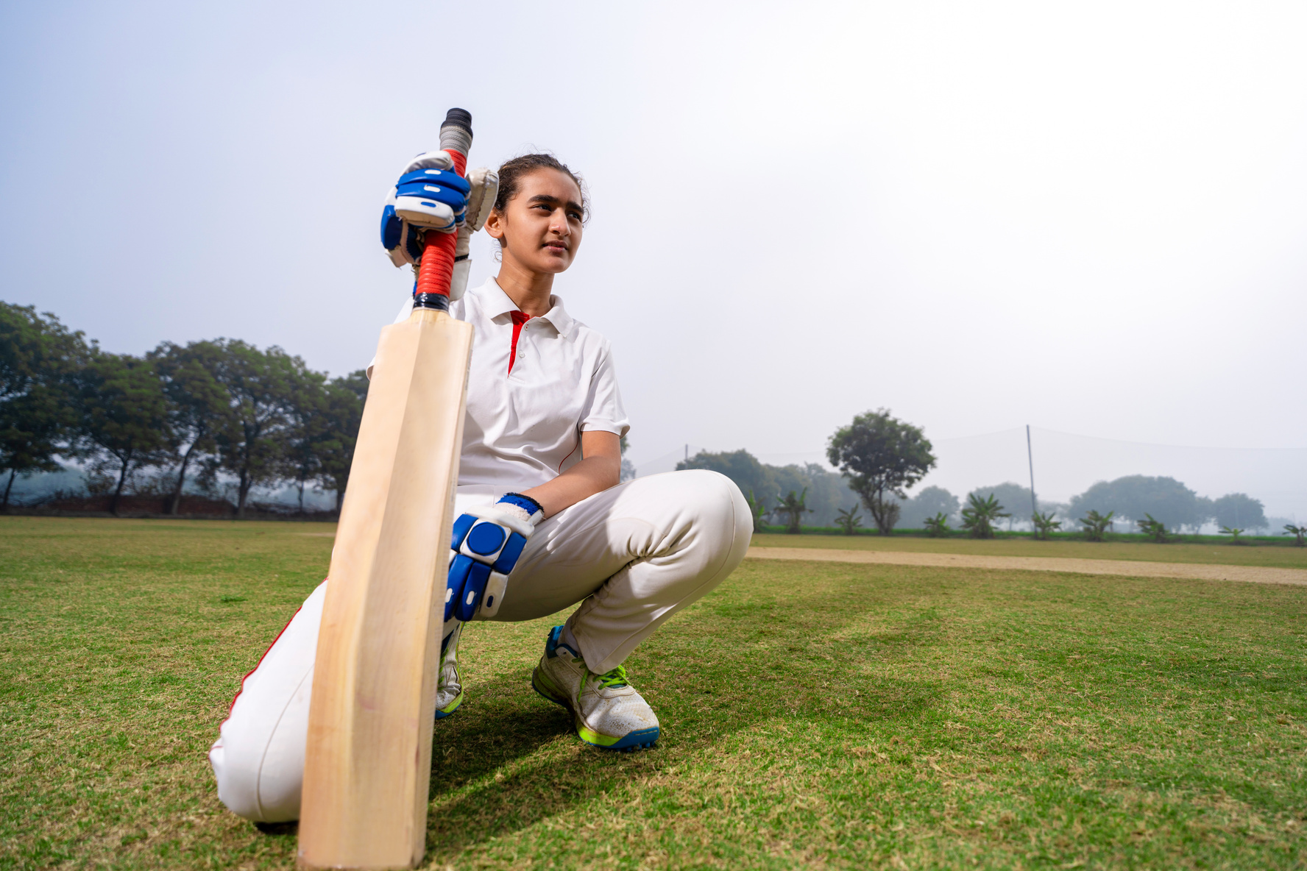
DATA CLEANING
Removed duplicates and irrelevant records
Handled missing values (mean/median for numerical, mode for categorical)
Encoded categorical features using Label/One-Hot Encoding
Standardized data formats for consistency
Final dataset prepared for modeling with no missing values

Slide 5

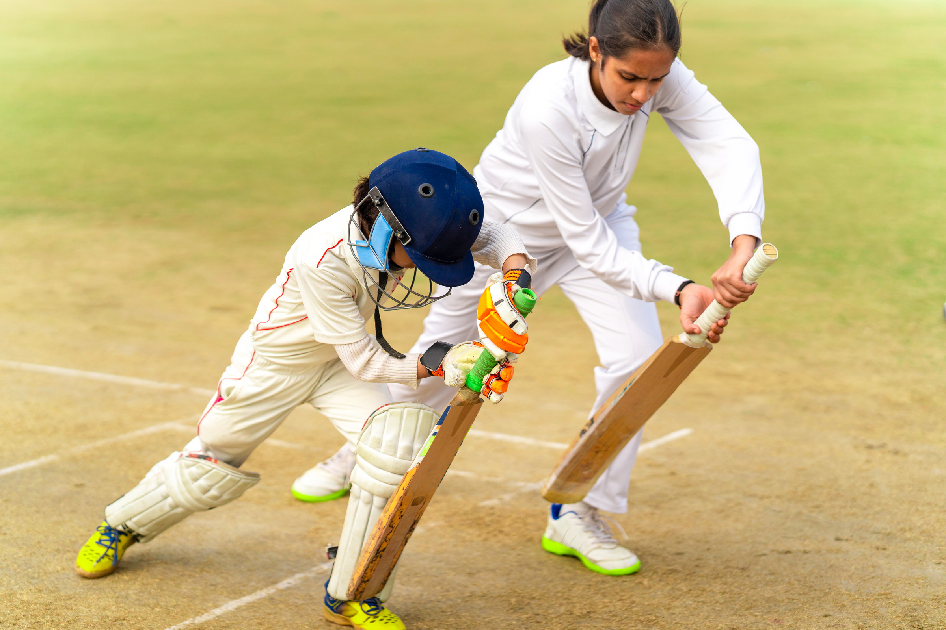
EXPLORATORY DATA ANALYSIS (EDA)
Helps understand the structure of the dataset and detect missing or inconsistent values.
Identifies patterns, trends, and relationships among different features (e.g., toss impact, venue effect).
Provides insights through visualizations and summary statistics to guide model building.

Slide 6
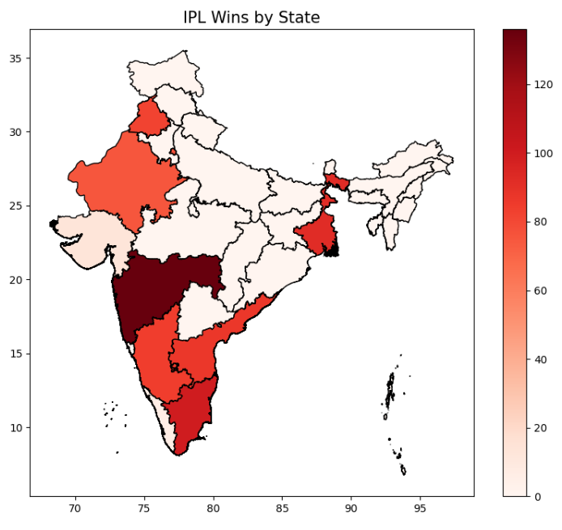

INSIGHTS
WINNING CITIES
Mumbai, Chennai, and Kolkata emerged as the top winning cities, while Gujarat and Kerala recorded the least wins.

Slide 7
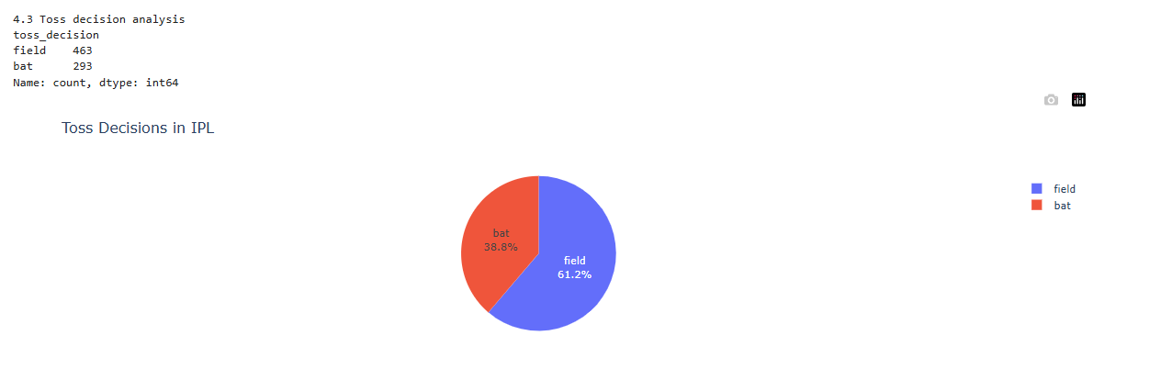
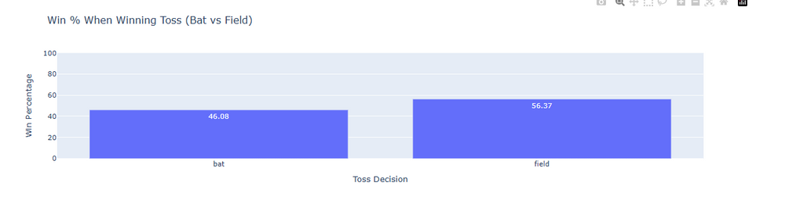

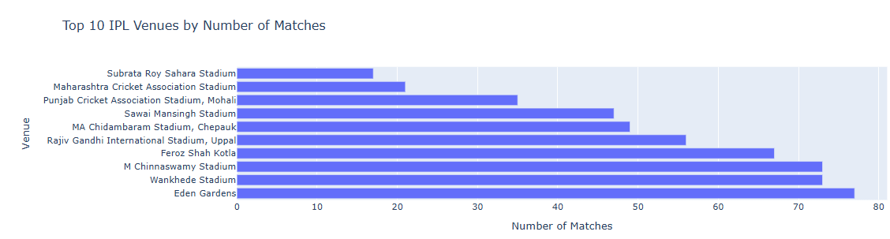

INSIGHTS
TOSS DECISION
Majority of teams prefer to field first (61.2%) after winning the toss compared to batting (38.8%).
Teams that choose to field first have a higher win rate (56.37%) compared to batting first (46.08%).
VENUE ANALYSIS
Eden Gardens, Wankhede Stadium, and M. Chinnaswamy Stadium have hosted the highest number of IPL matches.
Smaller venues like Subrata Roy Sahara Stadium and Maharashtra Cricket Association Stadium have hosted comparatively fewer matches.

Slide 8
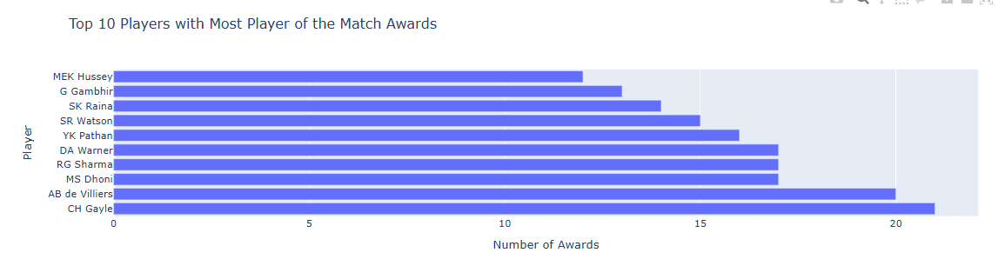
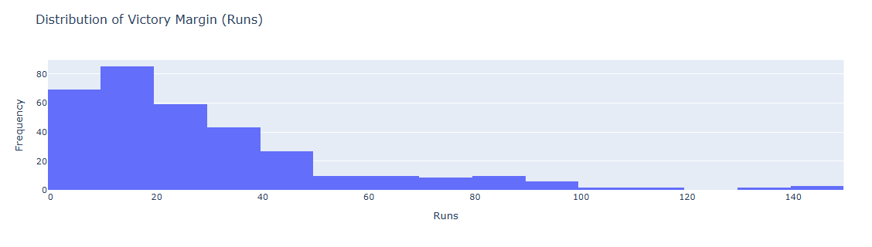

INSIGHTS
PLAYER OF THE MATCH
Chris Gayle and AB de Villiers lead the list with the highest number of Player of the Match awards in IPL history.
Other consistent performers include MS Dhoni, Rohit Sharma, and David Warner, highlighting their match-winning impact.
VICTORY MARGIN (RUNS)
Most IPL matches are won by small margins (10–30 runs), showing close competition between teams.
Very few matches are won by large margins (above 70 runs), highlighting that one-sided victories are rare.

Slide 9
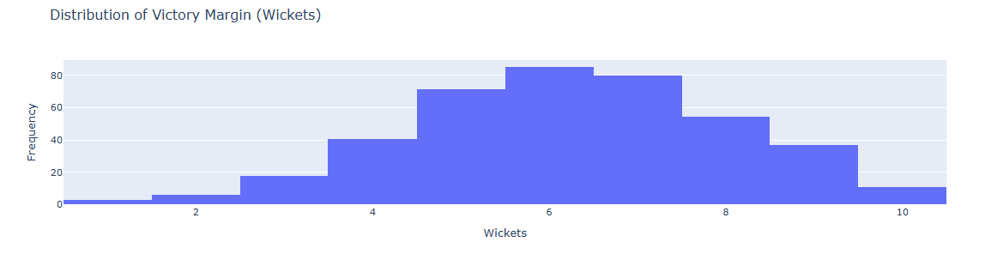
INSIGHTS
VICTORY MARGIN (WICKETS)
Most matches are won by 5–7 wickets, indicating comfortable chases, while narrow (1–2 wickets) and dominant (10 wickets) wins are rare.
Victory margins follow a bell-shaped distribution, suggesting a balanced mix of competitiveness in most matches.

Slide 10
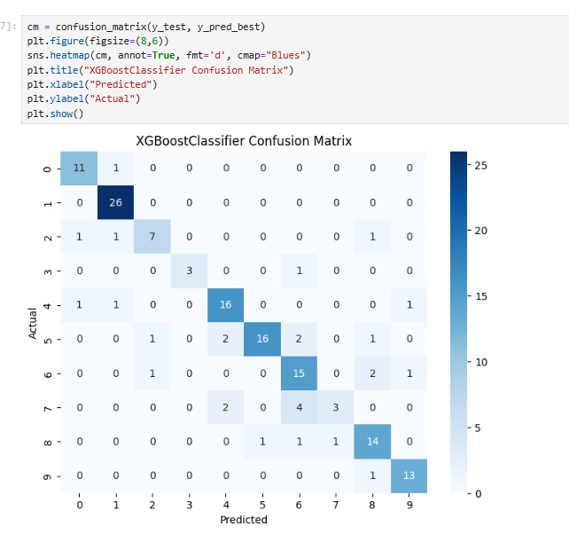
MODELING PROCESS
Models Used: Logistic Regression, SVM, KNN, Random Forest, XGBoost.
Hyperparameter Tuning: Grid Search for Random Forest & XGBoost; defaults for others.
Evaluation Metrics: Accuracy, Precision, Recall, F1-score.

Slide 11
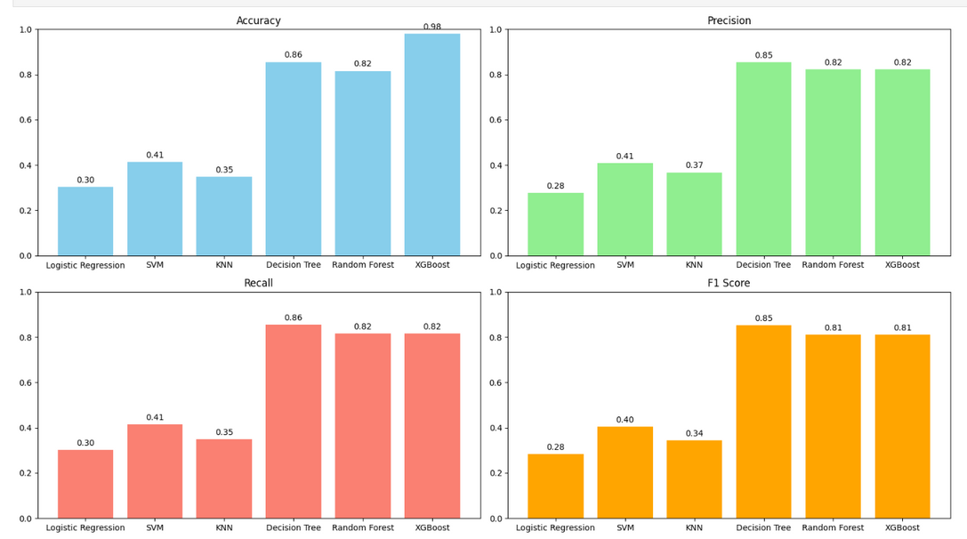
MODEL COMPARISON
XGBoost achieved the highest accuracy (0.98) followed by Decision Tree (0.86) and Random Forest (0.82).
Decision Tree showed the best balance across precision, recall, and F1-score.
Logistic Regression, SVM, and KNN performed relatively lower across all metrics.

Slide 12
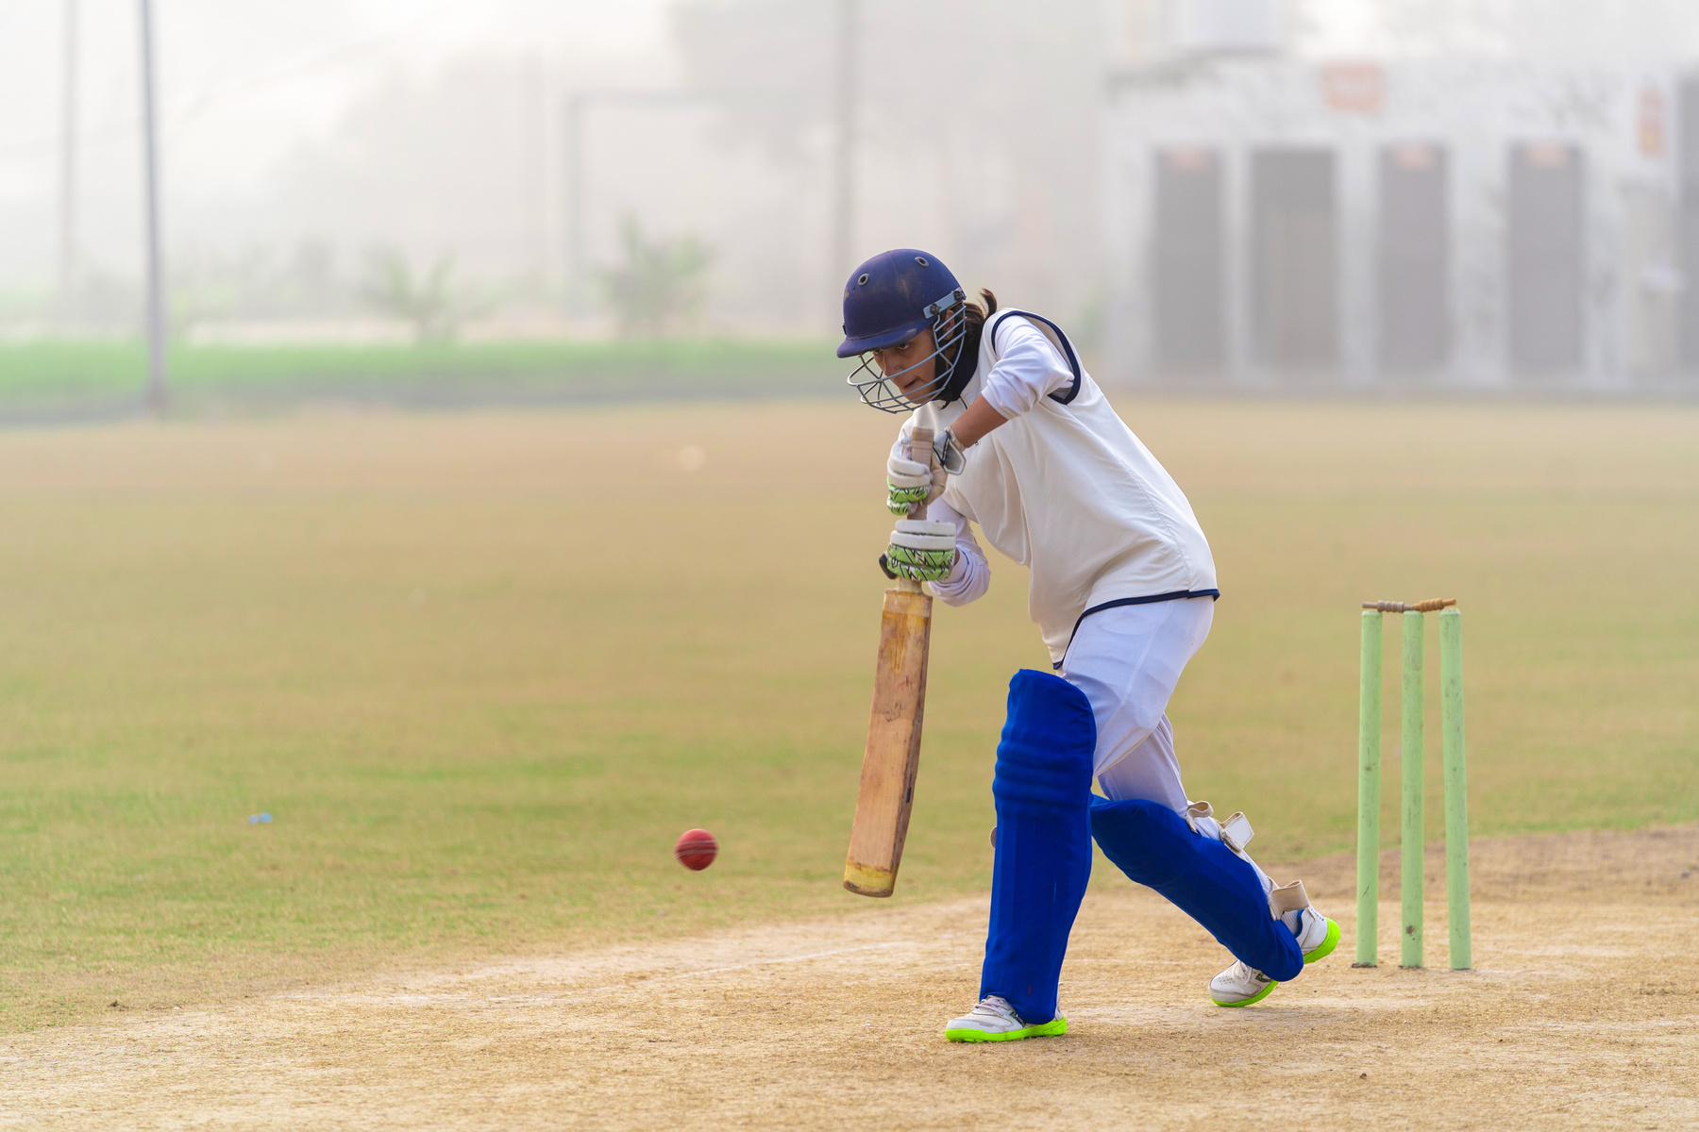
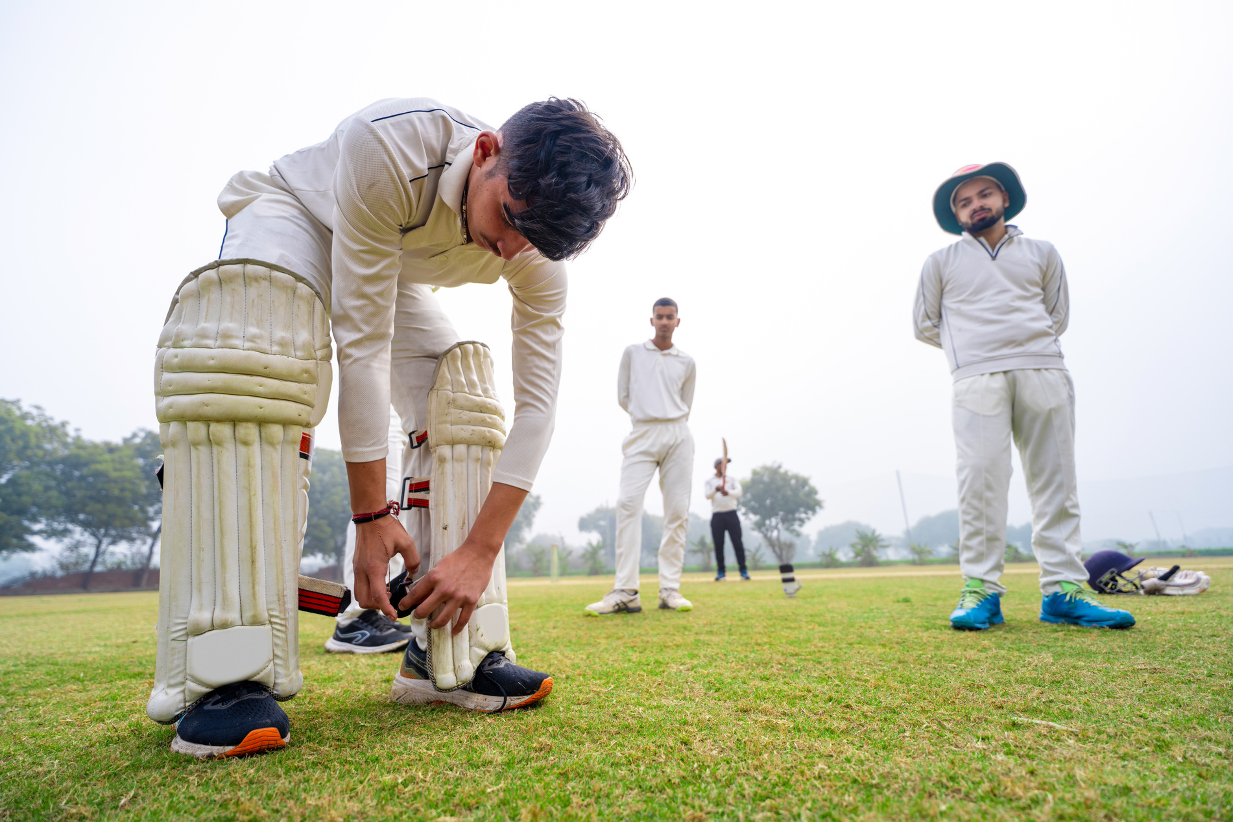

CONCLUSION
Machine learning models can effectively predict IPL match outcomes using match-related features.
Among tested models, ensemble methods like Random Forest and XGBoost performed the best after tuning.
The project highlights the importance of factors such as toss decisions, venue, and team performance in determining match results.

Slide 13
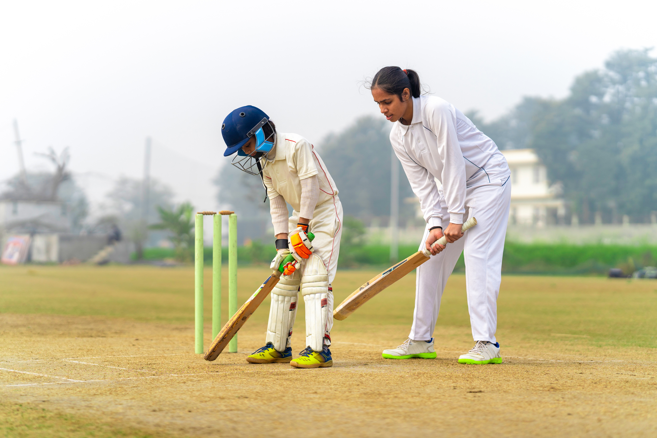
THANK YOU!

